Slide 1
Progress Report
Paddy Mahon – December 2022

Slide 2
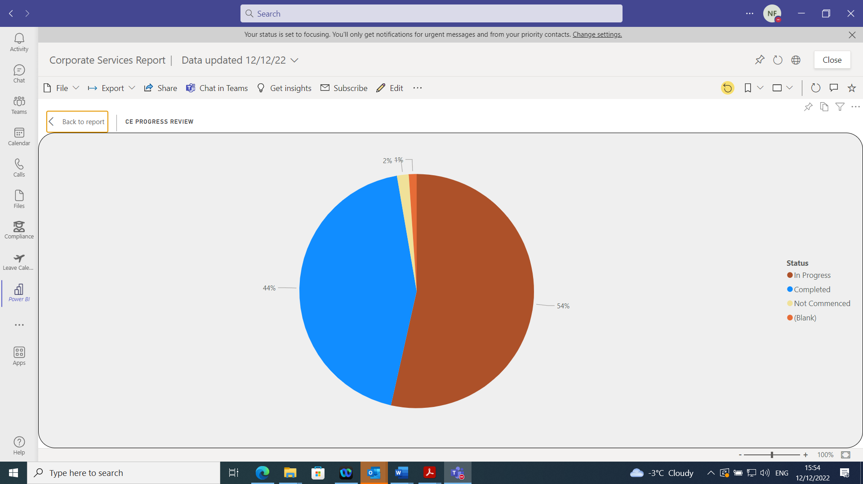

Slide 3
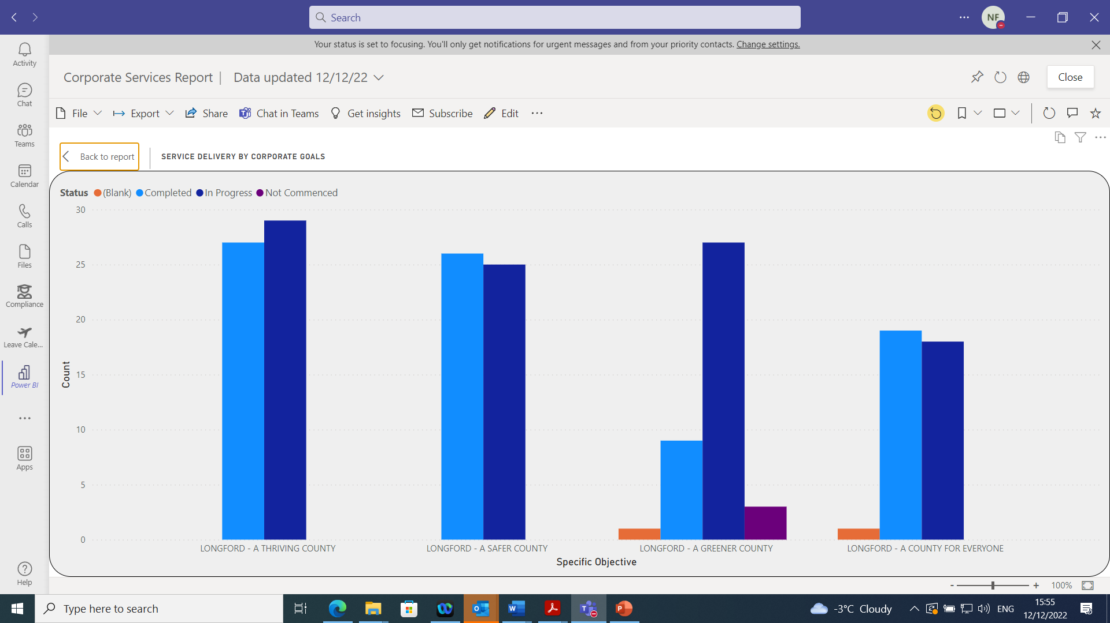

Slide 4
A Thriving County
Over 700 people from local businesses did some form of capacity and capability training through the local LEO office. Over 220 businesses have engages with the Shop Local Campaign. 17 local enterprises approved a total of €362,000 in grant support. Cirtex, a LEO client company won one of the main awards at this year’s National Enterprise Awards-LEO
Longford County Council Support the LCDC/LAG in its role of administering the LEADER Programme and providing LEADER grant assistance..10 projects approved for grant aid in excess of €594,000. Community
Milestone 7 upgrade successfully completed by target dates. Finance General and Accounts Payable
AFS completed ahead of statutory deadline, AFS 2021 was the first audited AFS in the country. Finance General and Accounts Payable
Article 48. This is complete to date. In 2022 so far there have been 41 claims reviewed with a further 5-8 expected to be received by the end of the year. 13 projects year to date have been reviewed and approved with four more expected by the end of the year. There were 24 projects in total approved in 2021. IGU, Audit & Compliance
5 long term vacant properties refurnished and tenanted in 2022. This completes our long term vacant voids-Housing

Slide 5
A Thriving County
Continue to improve our financial outlook through improvements in revenue collection rates. IGU, Audit & Compliance
Implement the Digital Strategy for Longford 2021-2023.Longford is one of the first Local Authorities to innovate its approach to County Digital Strategies. Leaving Cert Computer Science to be an option in secondary schools in the County. Longford is also on of the first Local Authority to reach out to industry to the benefit of primary schools with Microsoft freely delivering an introduction to technology to over 100 primary school children in North Longford with further days planned for the South. IT
Ballymahon My Open Library open. Granard and Edgeworthstown just required some H&S equipment first. Contract sent to the successful tender for installation of My Open Library for Lanesborough Library –Library
Continuous strong performance across the 20 KPI’s for Water Services reviewed by IW each quarter. Water Services & Environment
Anti-Dumping Initiative funded to community groups and works carried out by Environment section. 76k funding received for Bins in Ballymahon. Water Services & Environment
Lead & Support the Regeneration of our County Towns & Villages –Regeneration

Slide 6
A Safer County
Comprehensive health and wellbeing programme in place based on the four pillars of Mental, Physical, Social and Financial wellbeing. HR
Support the work of the Pilot Local Community Safety Partnership. Beyond Borders All island Community Safety conference held in November 2022. Community
Maintain ISO 450001 accreditation for the Health & Safety Management System. ISO 45001 Accreditation for Health & Safety Management System - Corporate
Longford County Council awarded Regional (Midlands) Award and Continuous High Achiever Award at the annual National Irish Safety Organisation / Northern Ireland Safety Group (NISO/NISG) All Ireland Safety Awards. Corporate
Longford was first county to introduce an innovative Corporate Planning monitoring framework. Strategic Links to Corporate Plan recognised in the NSAI audit of H&S management system, Proactively implemented NOAC recommendations. Corporate
Effectively promote Council’s role and achievements in delivery of services and projects to secure increased visibility and awareness of the Council. Whilst NOAC discontinued with individual local authority ratings, consider work of the Communications section such as press releases, website updates and guidance to other sections has delivered on this, Not possible to quantify in % terms -Corporate
Ensured consistent enforcement of our powers under various Environmental legislation - Environment
Since January 1st, 2021 76 approaches by Homeless Persons have been dealt with in the Housing Department. The provision of Emergency Accommodation for these 21 individuals over a total of 1,537 bed-nights so far in 2021 has cost €90,606.00 – Housing
Road Safety Improvement Works to the value of €265,500 at various locations throughout the County - Roads
The Fire Service helped to support and maintain safe, sustainable, and active communities in our county by maintaining the current operational Fire Service throughout the pandemic – Fire
We promoted and implemented best practice in Health and Safety through audits of work practice`s, procedures and documentation resulting in getting ISO 45001 accreditation for our Safety Management System – Fire
We partnered with other principal response agencies to plan and respond to emergencies by ensuring necessary planning, preparedness, capacity, training, and co-ordination is in place – Fire
The Early Contractor involvement Works is a nationally programmes aimed at carrying out improvement works at water treatment plants to ensure the continued delivery of safe drinking water – Water
Training for 17 Health & Safety competencies was delivered in 2021, catering for 373 employees – HR
Funding received from the Dept. of Justice to establish a new Local Community Safety Partnership in Longford on a pilot basis – Community
Award grants of €43,000 through the LCDC to support frontline organisations – Community

Slide 7
A Safer County
There is an experienced Procurement Officer in place providing excellent support throughout the organisation. In 2022 so far there have been 605 procrefs created and 220 contracts set up on SupplyGov. IGU, Audit & Compliance
Coordination of Longford Older Persons Council and Longford Age Friendly Alliance. Collaborate with Longford Community Gardai and Community Safety Partnership Coordinator to continue to promote the Crime Prevention awareness among our older citizens. Expand Crime Prevention Ambassador programme to Ballymahon and Granard MD. Preparation and Delivery of a new 5- year Age Friendly Strategy for the County. -Library
Action Teams for Gleann Riada, McKeon Park and Ardnacassa set up. Water Services & Environment
Over 2000 bed nights provided to those presenting as Homeless YTD. –Housing
GDPR and FOI requests completed as required. Training completed within the section.-HR

Slide 8
A Greener County
The promotion of the inclusion of climate related risks was incorporated into each meeting on the review of the operational risk registers that took place during the year. IGU, Audit & Compliance
Electricity Supply Board Planning Application - Lough Ree Power (LRP) Ash Disposal facility, Derraghan More & Derraghan Beg, Ballymahon, Co Longford -Planning
Integrate Climate and Environmental considerations into the design, planning, construction and administration of all Road Infrastructure. Roads
Implement measures which reduce our carbon emissions. Delivery of a 50% improvement in energy efficiency by 2030. Roads
Regular meetings and reporting on Climate Action Adaptation Strategy. Preliminary work for Climate Action Plan - Water Services & Environment
Reduce Environmental Pollution. Approximately 1505 complaints received to date. complaints closed – 1350. Water Services & Environment
298 of our current housing stock now has a BER rating of B2 or higher. –Housing
Review of documentation for eDMS in progress.. Climate action included in all new contracts of employment and as part of the recruitment process. HR

Slide 9
Comprehensive learning and development programme in place for employees focusing on lifelong learning.
Proactive, planned and regularly reviewed recruitment programme in place for the organisation to deliver effective and efficient services to our customers.
Implementation of a performance management and development system strategically aligned to the Corporate Plan –HR
Continue to support diversity in our community. Level of support to DRCD projects for LGBTI groups. 2 projects completed. Community
Implement other initiatives that promote and support communities eg CLÁR scheme, Community grant support scheme, Playground scheme, Age Friendly Programme. 15 schemes approved by DRCD with grant funding of over €530,000- Community
Support the LCDC in implementing the Healthy Longford Programme. Developed the Pilot Slaintecare Healthy Communities Programme . Minister of State for Public Health launched the Slaintecare Healthy Communities Programme in December 2022 -Community
Strengthen the visibility of the Council’s data processing to inform and enable citizens. Performance standard met and exceeded by 8%, 88% completion being most recent figure in respect of policies and training on metacompliance platform Detailed review of ROPA's enabled updating of the Council's Privacy Notice and a privacy notice on personal data processing is now available for each section, DP information in a clear and more accessible format on the website –Corporate

Slide 10
There are now over 50 persons in pledged properties in County Longford
Longford has established a dynamic and responsive community fora
Successfully ran an Emergency Rest Centre for 4 weeks in Keenagh with great volunteer help from Longford County Council staff –Ukraine
Modernise the Electoral Registration process. Significant changes introduced to the electoral registration process.–Corporate
Work with the local authority, other agencies and community groups.Co Worx opened. School Education packs and family packs at The Latin School at Moyne Visitor Centre in progress. Library
Support Twinning in our MD’s –Library
Heritage Week was a huge successful in 2022.
Disability Awareness Training delivered for all employees and elected members. HR
The Residential Zoned Land Tax (RZLT) was introduced as part of the Finance Bill 2021 to activate land for development to increase housing supply. The tax potentially imposes a 3% annual market value tax (self assessed), on lands zoned suitable for residential development and will be administered by the Revenue Commissioners. Planning

Slide 11
Center Parcs Planning Application – Decision made 27th September 2022 -Planning
Planning received 14 Part VIII’s applications in 2022 of which 12 have been adopted by the members.
The Planning Department play an important role in the implementation of the National Broadband Plan by continuing the processing of Section 254 Licences. Planning
Enable every person in Longford to have the opportunity to realise their full creative potential. Implement appropriate strategies, policies, plans and actions which support integration, creativity and improved health and well being outcomes for citizens. Public Consultations completed including Voice of the child. Starting to write the strategy –Library
Deliver environmental awareness and education strategies including the Green Schools Programme. 100% of schools have applied for Green Flag status -Water Services & Environment
An anticipated 150+ new tenancies commenced in 2022. Housing
In 2022 adaptation work will be completed on 28 Council owned properties at a cost of almost €187K –Housing

